Slide 1

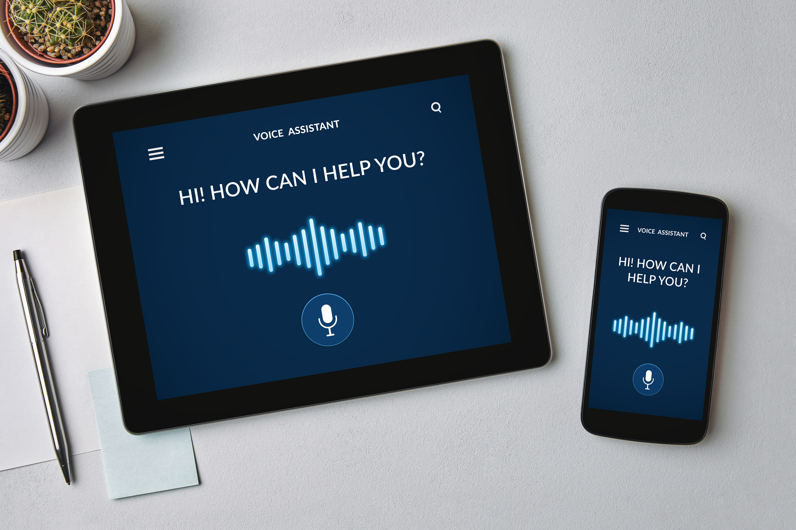
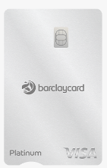
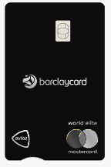
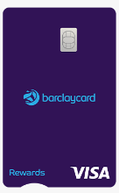
Barclays Voice Card
Your Voice
Your CARD
REWARDS? CREDIT BUILDER? AVIOS? BALANCE TRANSFER ?
Your voice is my command!
Simplifying Your Barclaycard Journey with seamless Alexa's Voice Assistant and Azure speech cognitive services for Credit Card Quotations.
Jugadu Coders

Slide 2
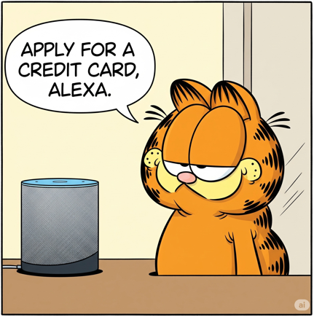



Use Case
In the current digital banking landscape, while mobile apps and websites offer various self-service options, voice-assisted banking—particularly using Azure speech cognitive services or Alexa for credit card applications—remains largely unexplored. Barclays has not yet integrated voice assistants like Alexa into the credit card application process, creating a gap in hands-free, personalized, and conversational banking experiences.
This gap presents a significant opportunity for innovation. Our solution, Barclays voice card, is a secure, compliant, and user-friendly voice application utilizing Azure speech cognitive services or Alexa to facilitate credit card applications, aligning with modern consumer behavior and accessibility needs.
HELLO GARFIELD ! WHAT WILL YOU USE THIS CARD FOR?
UMM..I WANT TO SHOP TILL I DROP , HMPH!
LET’S CHECK YOUR ELIGIBILITY FOR BARCLAYS REWARDS CARD ! CAN YOU HELP ME THROUGH SOME DETAILS ?
OFCOURSE!
WHAT’S YOUR DATE OF BIRTH?
ANNUAL INCOME?
MONTHLY EXPENSE?.....
BASED ON YOUR PERSONAL , INCOME DETAILS AND VERIFICATION VIA BUREAU YOU ARE ACCEPTED FOR BARCLAYS REWARDS CARD!
WOO-HOO! LET’S GO SHOPPING ! YEAYY..YEAYY

Slide 3

USP and Key features
WHAT?
Voice-driven application for credit card quotations
FEATURES
Voice-only interaction via Alexa devices
Natural conversation flow for quote process
Quotation ID generation through API
Follow-up question handling
Secure data storage and processing
Backend processing visualization
WHO?
Designed for all customer including vulnerable ones
HOW?
Smart home device integration via Cognitive Speech
BENEFITS OVER CURRENT SOLUTIONS
No toll-free number required
Works on any Alexa-enabled device
Leverages advanced NLP capabilities
More natural conversation experience
Support for follow-up questions
WHY?
Enhanced accessibility via natural voice interaction
APPLYING FOR A CREDIT CARD WITH VOICE

Slide 4
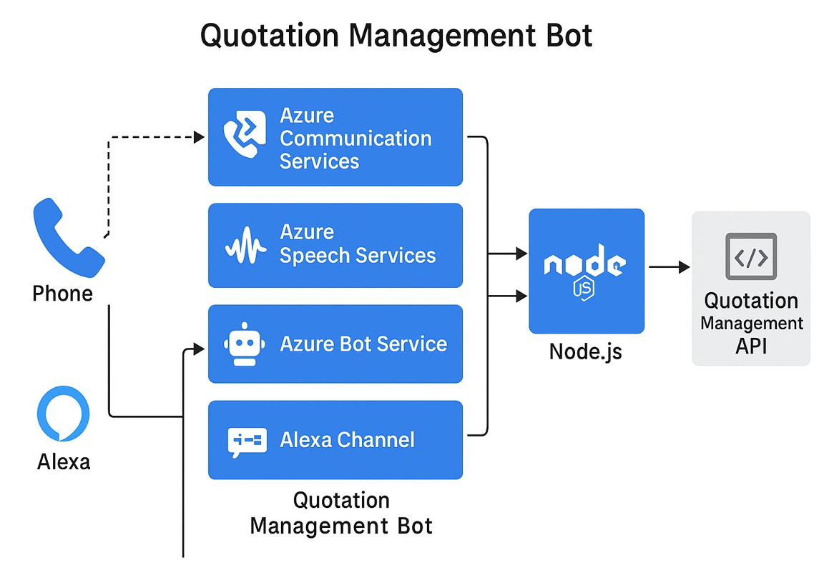
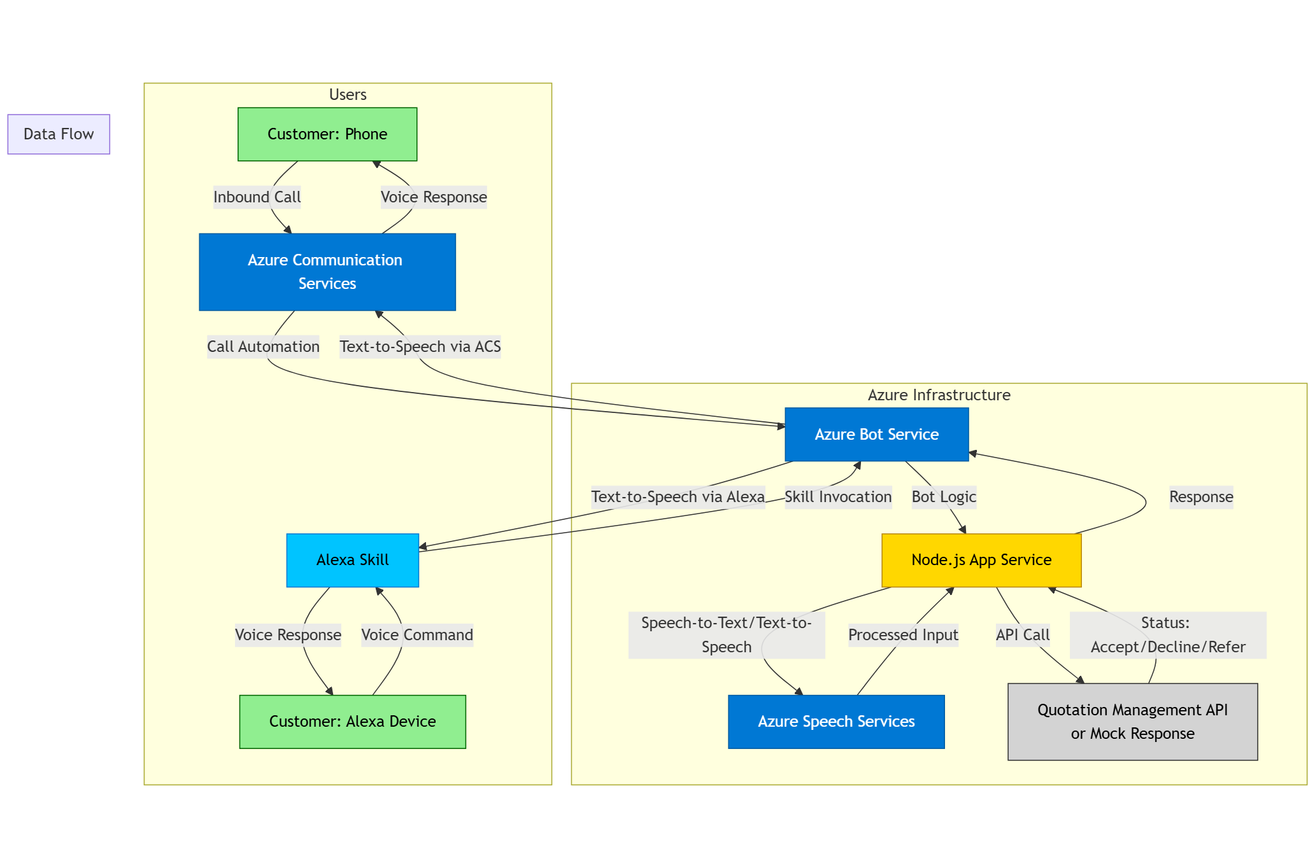
Architecture and Integration
Notes:
This slide highlights innovative strategies for implementing the voice-driven credit card quotation system. It emphasizes the importance of user data confidentiality and compliance with GDPR regulations while also detailing the timeframe for rollout and the advanced technologies employed.

Slide 5
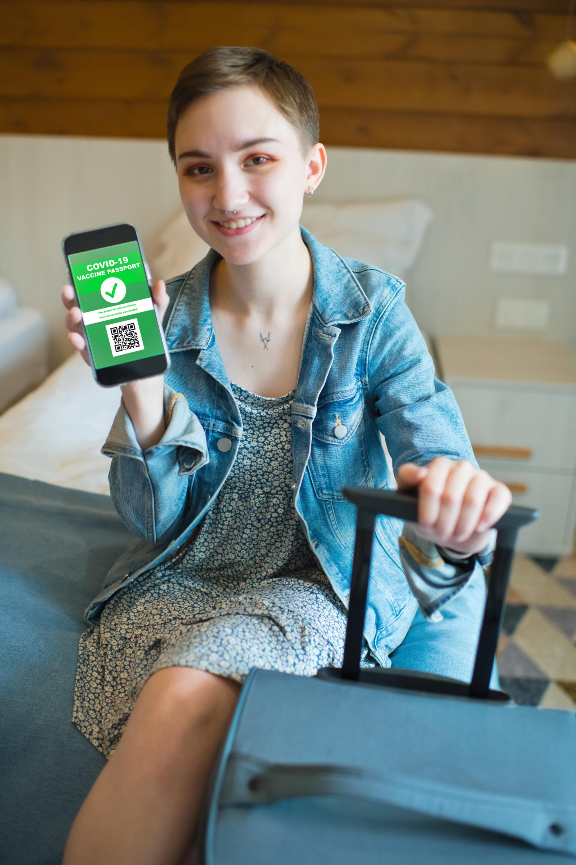
Banking for People and Planet
Accessibility for over 2 million visually impaired individuals in the UK.
Digital inclusion through user-friendly interfaces for the elderly.
Financial empowerment enables 24/7 independent decision-making.
40% increase in visually impaired credit card applications.
35% completion rate among elderly users.
Environmental impact with reduced paper usage and travel.
Reduces application time from 12 minutes to 4 minutes
Eliminates need for visual interface
Reduces call center volume by 22%
Automates routine application processing
Notes:
This slide highlights the social impact of our banking initiatives. We focus on accessibility for visually impaired individuals and support for elderly users through intuitive interfaces. The measurable results showcase our success in increasing applications and completion rates. Additionally, we emphasize our commitment to sustainability through reduced environmental impact.

Slide 6

Innovative Implementation Strategies
First-to-market voice-driven credit card quotation system, rollout in 24-32 weeks.
User data confidentiality is prioritized with GDPR compliance.
Creates new customer acquisition channel
Azure Key Vault facilitates secure credential management.
Real-time audit trails maintain transparency in transactions.
Cutting-edge NLP technology reshapes financial service interactions.
Notes:
This slide emphasizes the innovative strategies for implementing the voice-driven credit card application system. The focus on a structured timeline, strict adherence to data privacy laws, and leveraging advanced technology ensures a smooth transition. Highlighting the significance of security measures like voice biometrics and Azure Key Vault reinforces the commitment to user trust and operational efficiency.

Slide 7

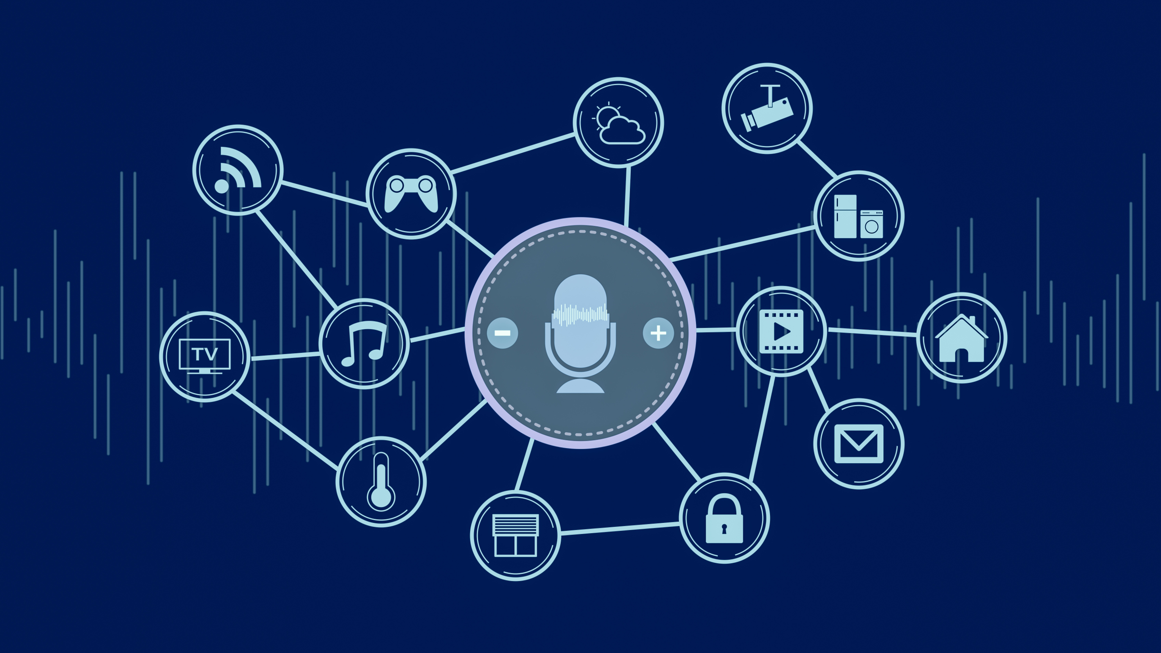

Thank YOU !
Time for Demo!

